Slide 1
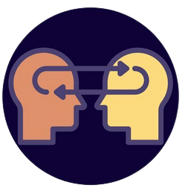
Rise of Transfer Learning
Dr. Erdi Kara
Spelman College, Mathematics

Slide 2
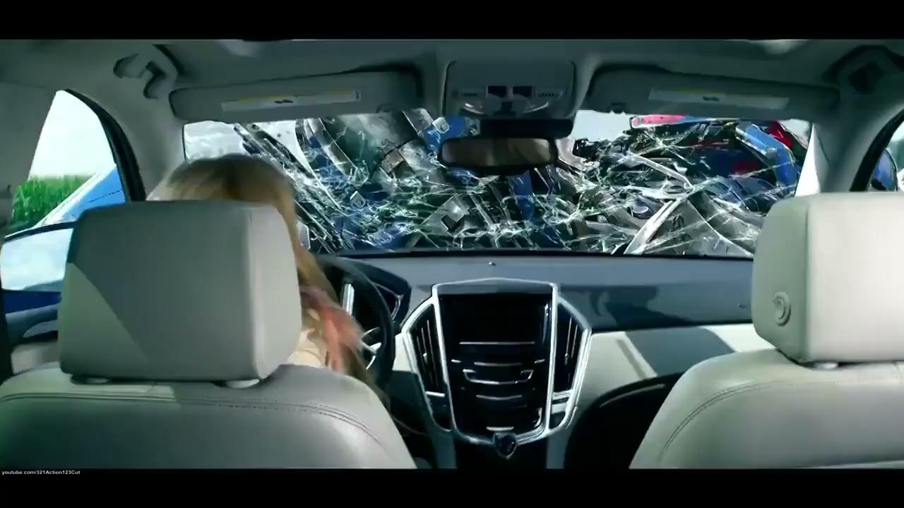
Trouble with loyalty to the cause is that the cause will always betray you…
Notes:
Where we are? Is this a hype or a real breakthrough?

Slide 3
How do machines algorithm learn?
Transfer Learning
Examples
YOLO
Stable Diffusion
Whisper
Transformers
Notes:
Very logical conversation

Slide 4
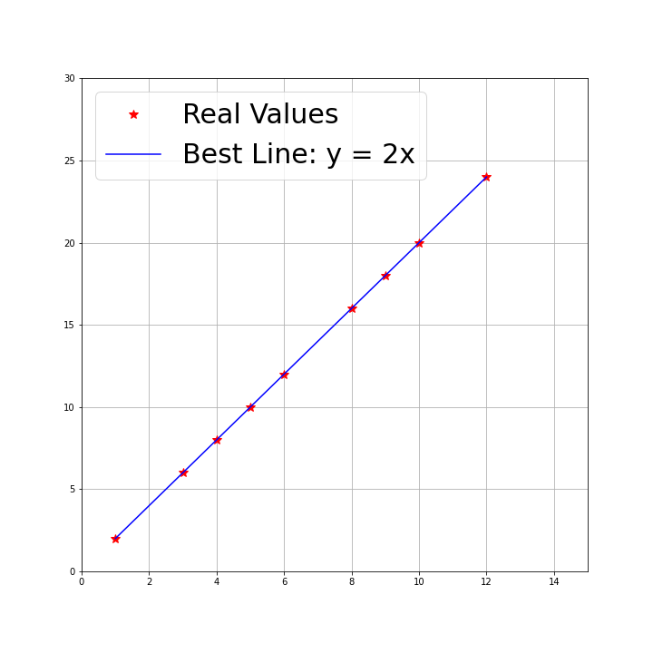
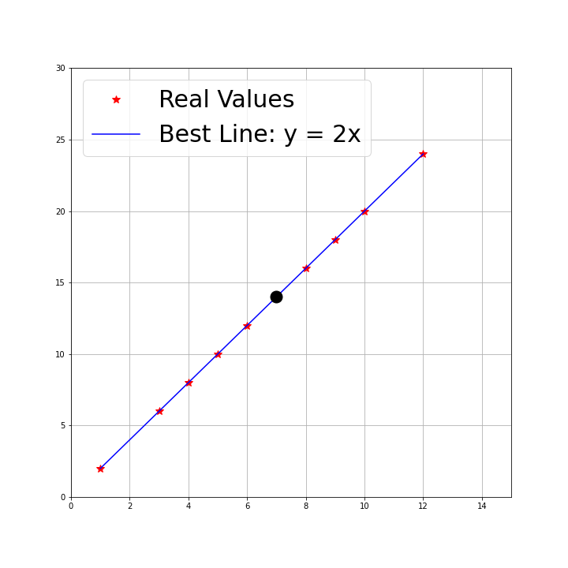
x: [ 1 3 4 5 6 8 9 10 12]
y :[ 2 6 8 10 12 16 18 20 24]
Find the best line y=mx+b. Predict y if x=7.

Slide 5
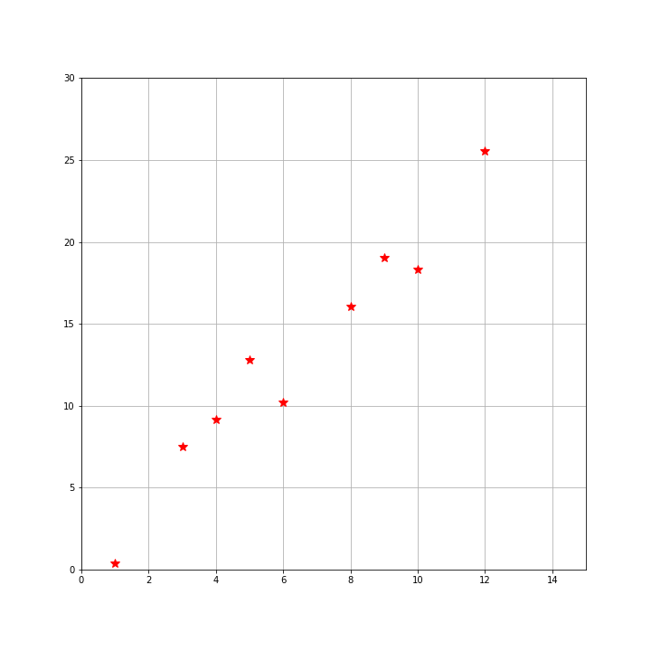
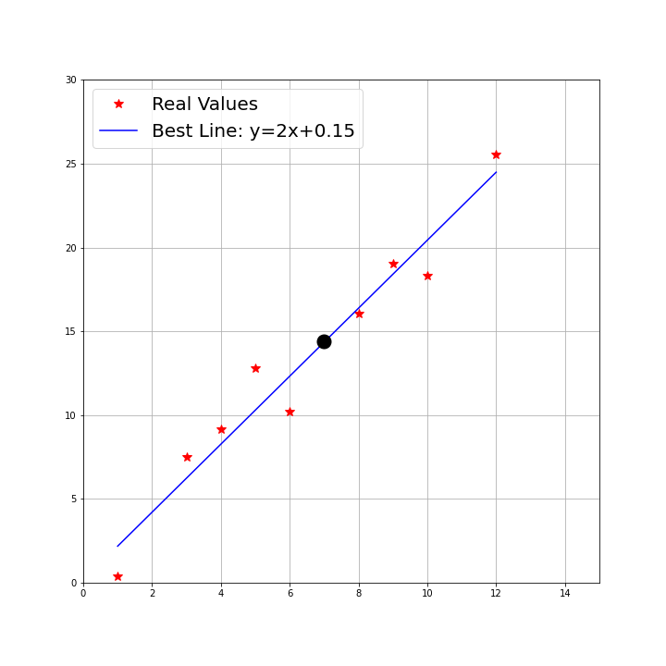
x: [ 1 3 4 5 6 8 9 10 12]
y :[ 0.4 7.5 9.2 12.8 10.2 16.1 19. 18.3 25.6]
Find the best line y=mx+b. Predict y if x=7.

Slide 6
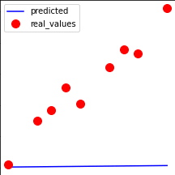
How did the algorithm learn m and b? Function approximation!

Slide 7
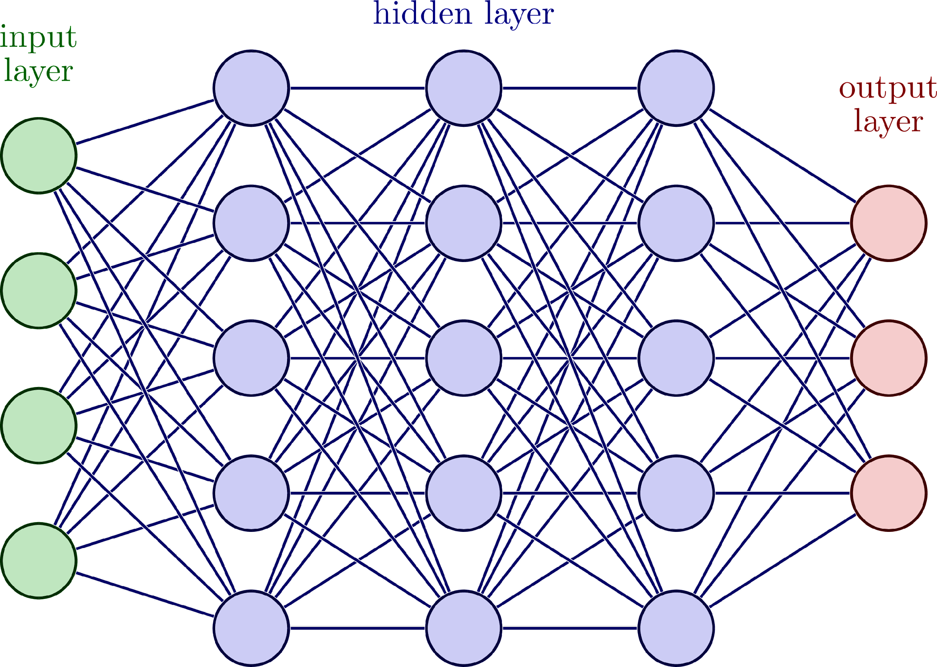
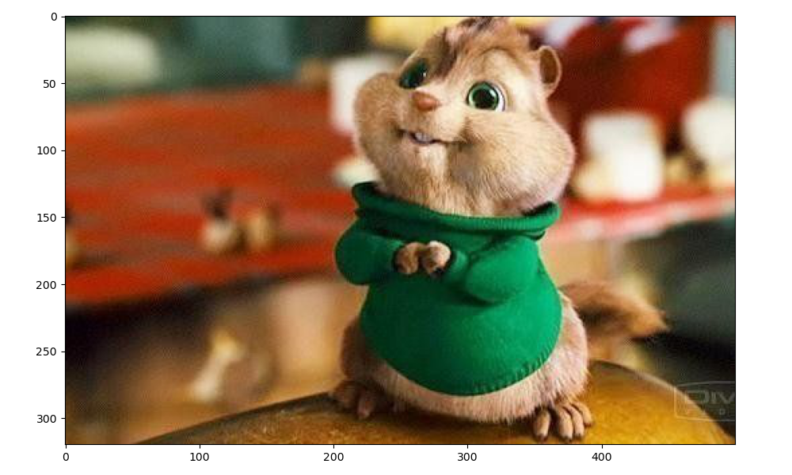
Chipmunk: 0.92
Squirrel: 0.05
Moose: 0.03
MODEL
(FUNCTION)
480,000 parameters
How many data points are there?
How many parameters should my model have? A lot…
Do not reinvent the wheel, just borrow the model from someone(:
Notes:
Image is 320x500=480,000

Slide 8
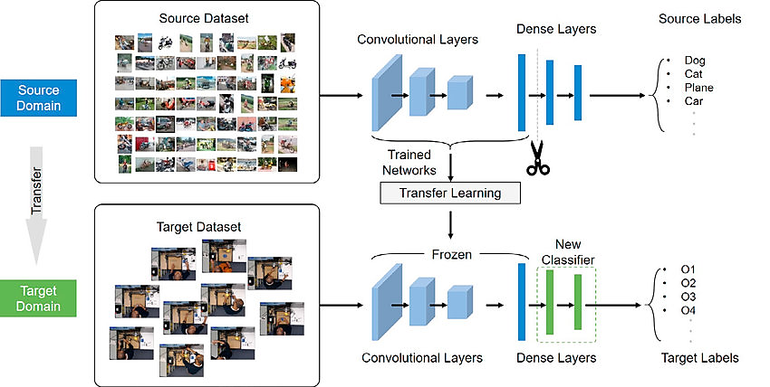
Transfer Learning: AI by the people, for the people
Use a PRETRAINED model on a new problem.
Either use it directly or modify the model based on your need.

Slide 9
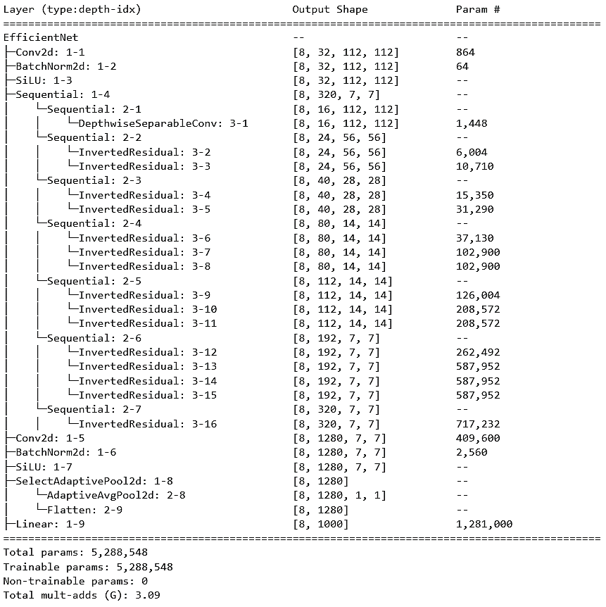
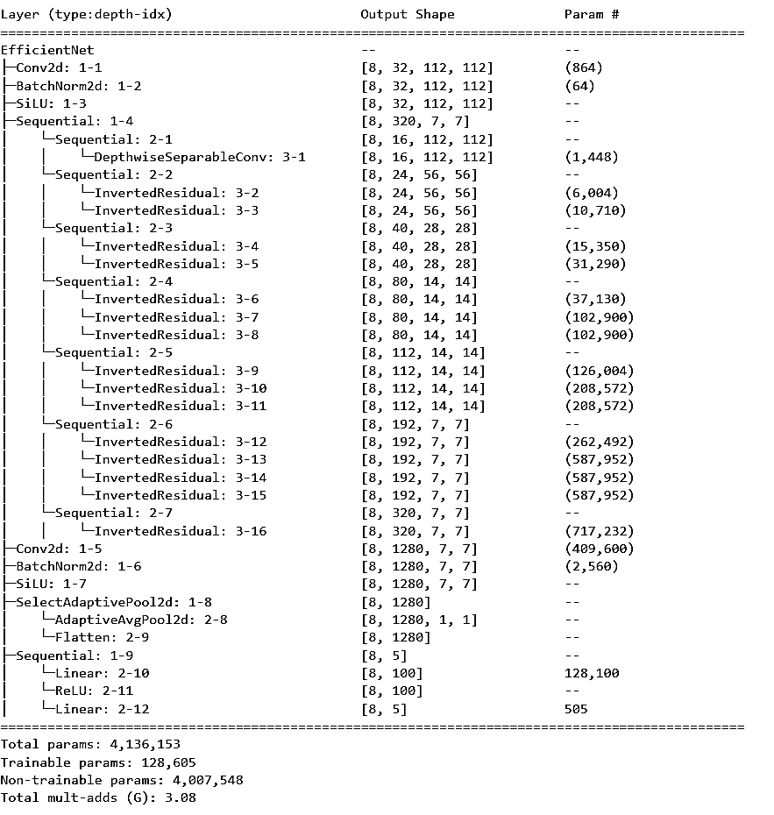
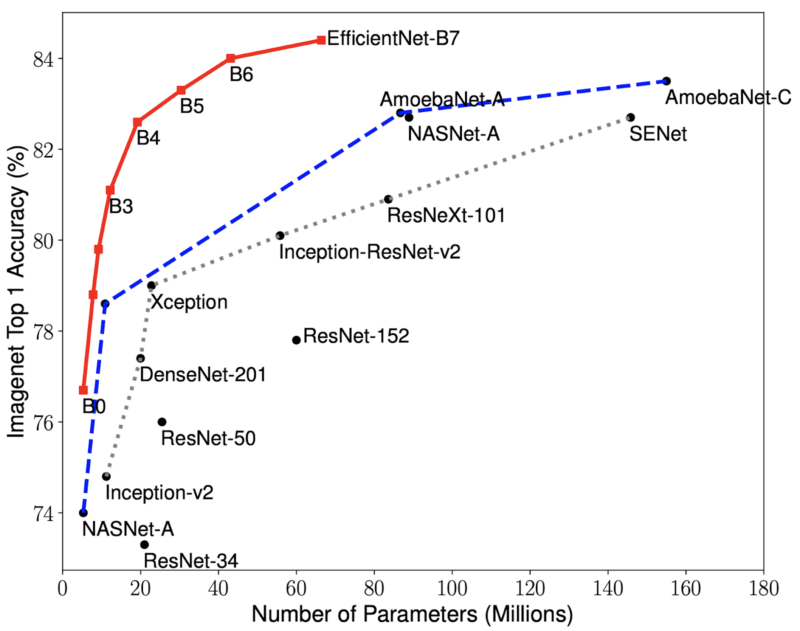

Slide 10
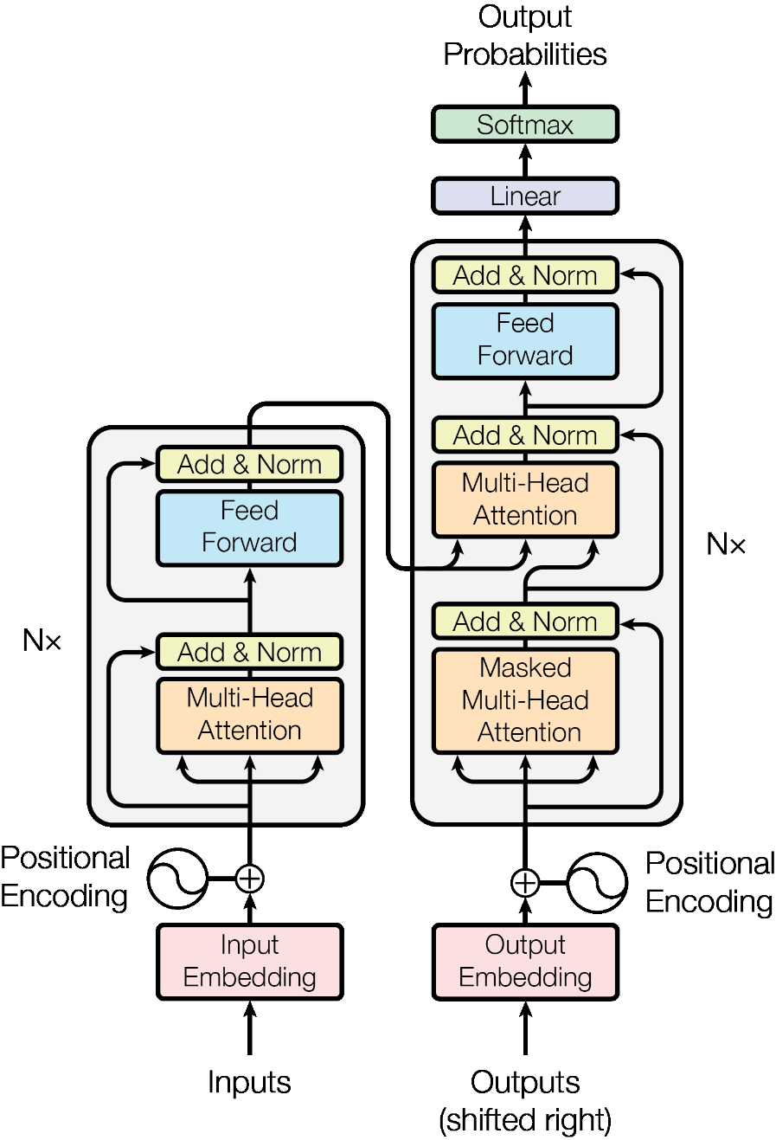
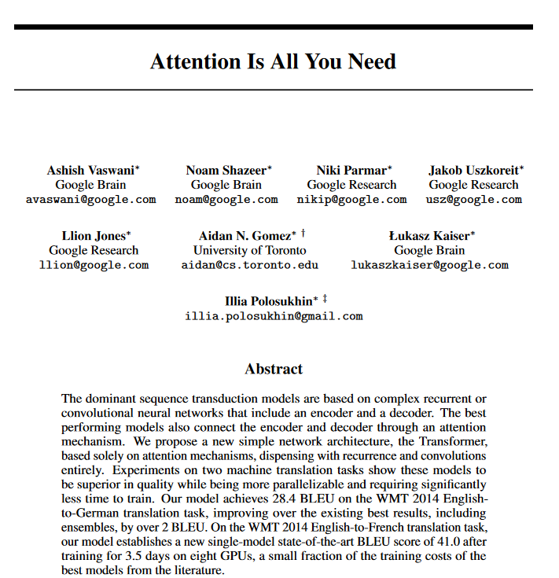
ChatGPT
Generative
Pretrained
Transformers
66157 citations as of 2023
Hundreds of start-ups and applications…
TRANSFORMERS

Slide 11
Where to find models? Where to start?
Learn little bit Python.
Understand the input and output.
Grab a project you find exciting.
Check out the Hugging Face platform. We will see some examples by the end of this talk.

Slide 12

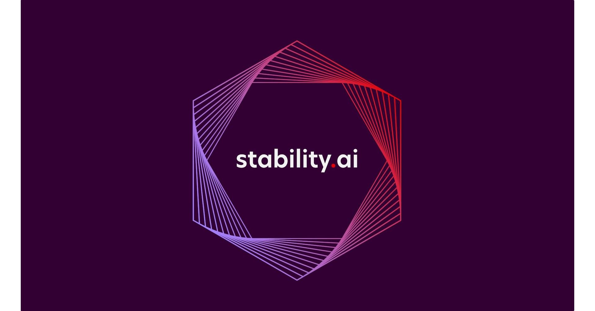

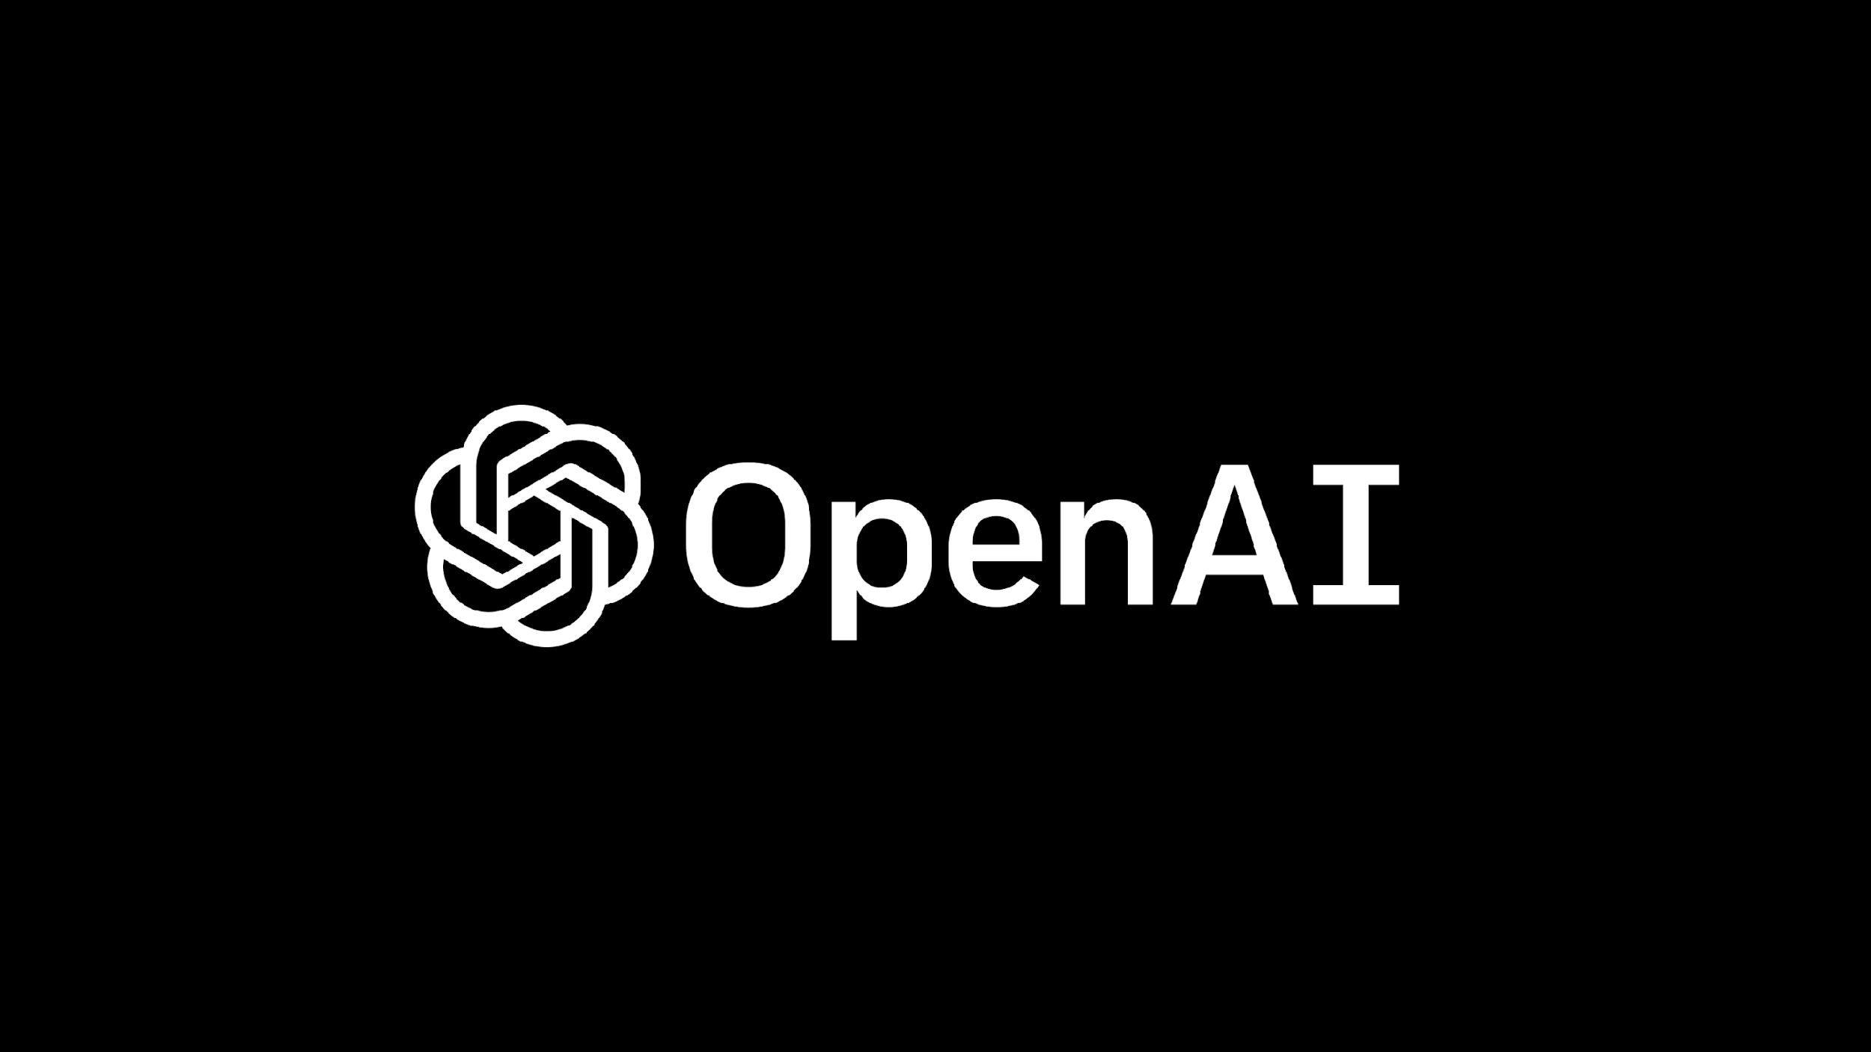
Some Popular Examples
1
2
3
4
YOLO
object detection
input: image, video output: bounding box
Stable Diffusion
image generation
input: text output: image
Transformers
Everything about text and more
Whisper
transcribe
input: audio
output: text

Slide 13
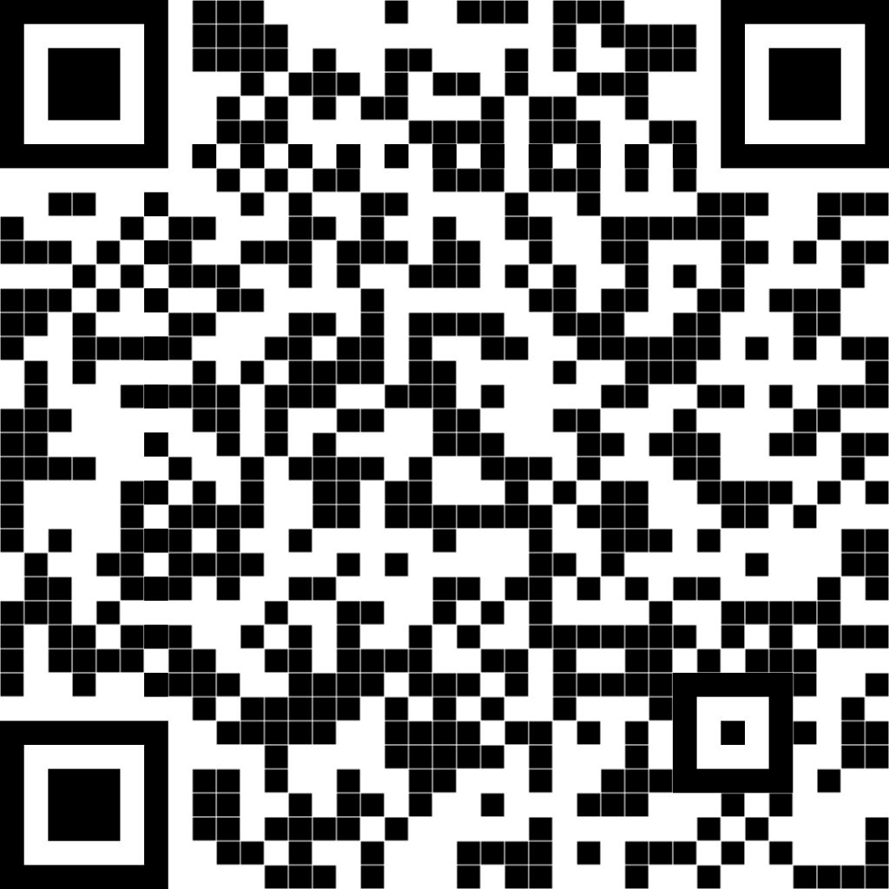
Try out the repository!

Slide 14


Organizations To Follow

Slide 15
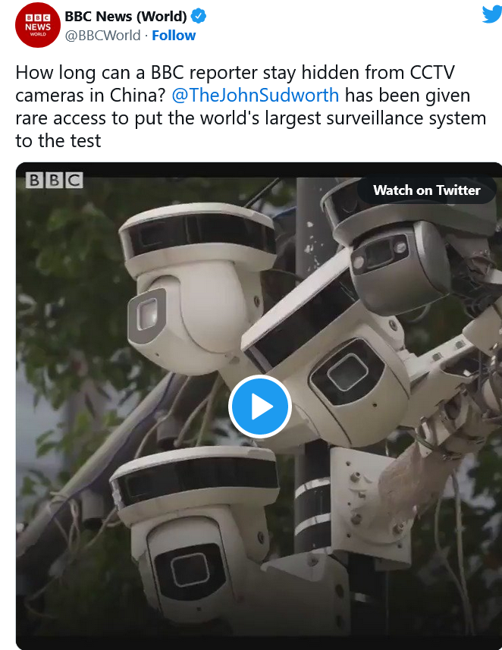
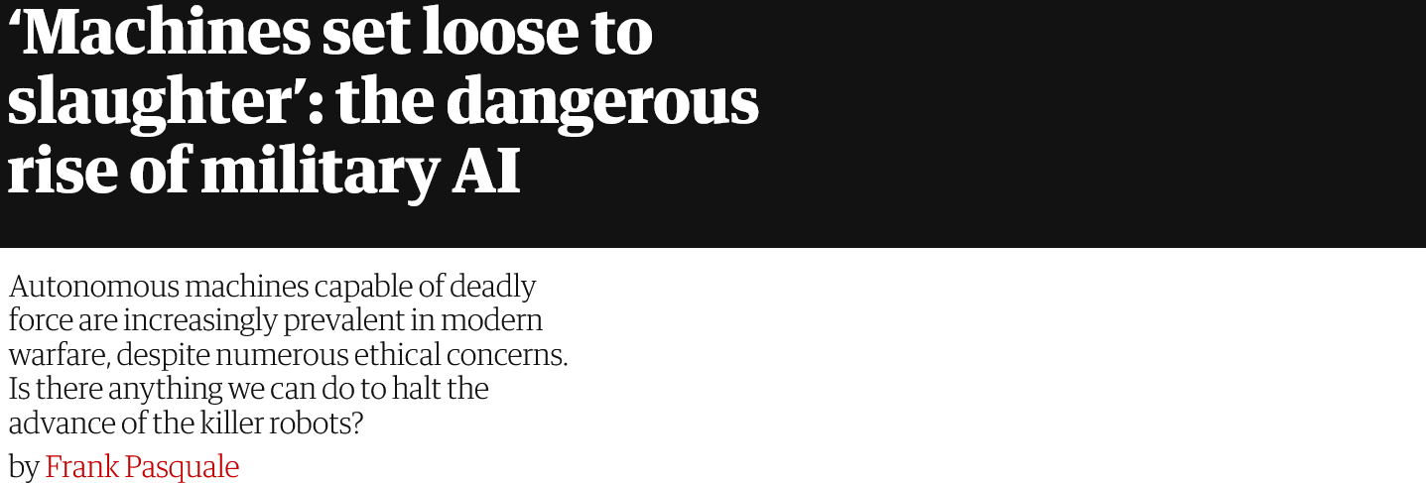
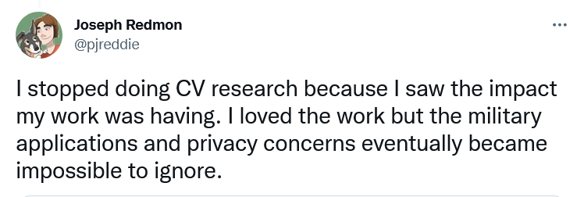
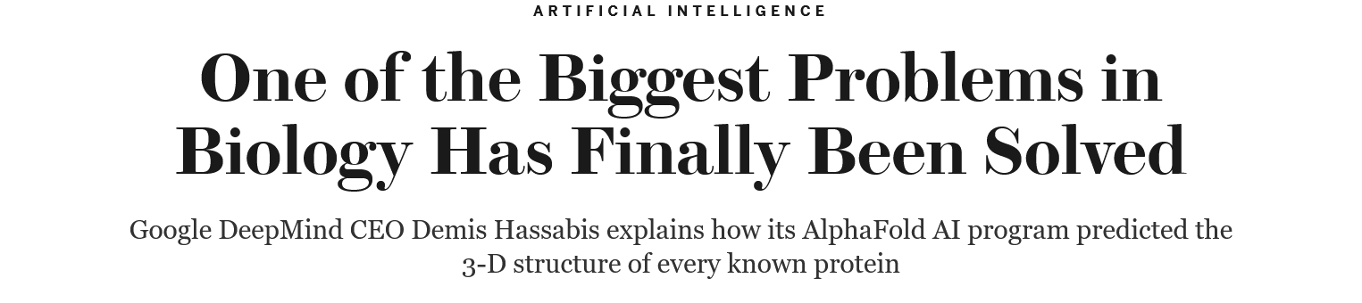

Thoughts?
Right now, our machines are like smart insects, eventually they will be as smart as mice. After that maybe as smart as dogs and cats. Probably by the end of the century, who knows, they will be as smart as monkeys.
Michio Kaku, Professor of Theoretical Physics, City College of New York.

Slide 16
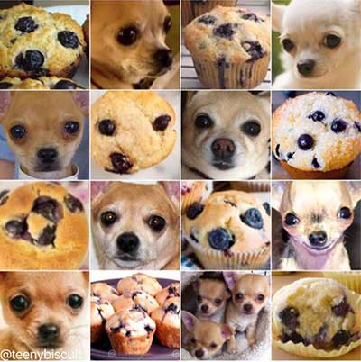
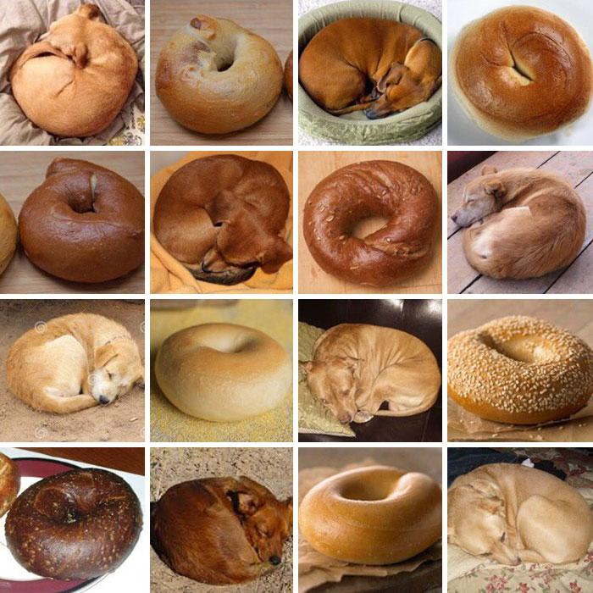
Not so fast!
Notes:
Fill the gap between human learning and machine intelligence…

